Slide 1
Web Mining – The Idea
In recent years the growth of the World Wide Web exceeded all expectations. Today there are several billions of HTML documents, pictures and other multimedia files available via internet and the number is still rising. But considering the impressive variety of the web, retrieving interesting content has become a very difficult task.

Slide 2
Web Mining
Web is the single largest data source in the world
Due to heterogeneity and lack of structure of web data, mining is a challenging task
Multidisciplinary field:
  data mining, machine learning, natural language
  processing, statistics, databases, information
  retrieval, multimedia, etc.
The 14th International World Wide Web Conference (WWW-2005),
May 10-14, 2005, Chiba, Japan
Web Content Mining
Bing Liu

Slide 3
Opportunities and Challenges
Web offers an unprecedented opportunity and challenge to data mining
  The amount of information on the Web is huge, and easily accessible.
  The coverage of Web information is very wide and diverse. One can find information about almost anything.
  Information/data of almost all types exist on the Web, e.g., structured tables, texts, multimedia data, etc.
  Much of the Web information is semi-structured due to the nested structure of HTML code.
  Much of the Web information is linked. There are hyperlinks among pages within a site, and across different sites.
  Much of the Web information is redundant. The same piece of information or its variants may appear in many pages.
The 14th International World Wide Web Conference (WWW-2005),
May 10-14, 2005, Chiba, Japan
Web Content Mining
Bing Liu

Slide 4
Opportunities and Challenges
  The Web is noisy. A Web page typically contains a mixture of many kinds of information, e.g., main contents, advertisements, navigation panels, copyright notices, etc.
  The Web is also about services. Many Web sites and pages enable people to perform operations with input parameters, i.e., they provide services.
  The Web is dynamic. Information on the Web changes constantly. Keeping up with the changes and monitoring the changes are important issues.
  Above all, the Web is a virtual society. It is not only about data, information and services, but also about interactions among people, organizations and automatic systems, i.e., communities.

Slide 5
Web Mining
The term created by Orem Etzioni (1996)
Application of data mining techniques to automatically discover and extract information from
Web data

Slide 6
Data Mining vs. Web Mining
Traditional data mining
  data is structured and relational
  well-defined tables, columns, rows, keys, and constraints.
Web data
  Semi-structured and unstructured
  readily available data
  rich in features and patterns

Slide 7
Web Data
Web Structure
tag
Click here to Shop Online

Slide 8
Web Data
Web Usage
Application Server logs
Http logs

Slide 9
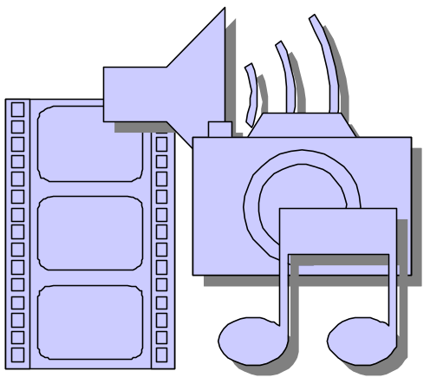


Web Data
Web Content
Image
Notes:
http://www.cs.berkeley.edu/~soumen/mining-the-web/

Slide 10
Classification of Web Mining Techniques
Web Content Mining
Web-Structure Mining
Web-Usage Mining

Slide 11
Web-Structure Mining
Generate structural summary about the Web site and Web page
Depending upon the hyperlink, ‘Categorizing the Web pages and the related Information @ inter domain level
Discovering the Web Page Structure.
Discovering the nature of the hierarchy of hyperlinks in the website and its structure.
Web Mining
Presented by: Gaurao Bardia
Web Structure
Mining
Web Content
Mining
Web Usage
Mining

Slide 12
Web-Structure Mining cont…
Finding Information about web pages
Inference on Hyperlink
Retrieving information about the relevance and the quality of the web page.
Finding the authoritative on the topic and content.
The web page contains not only information but also hyperlinks, which contains huge amount of annotation.
Hyperlink identifies author’s endorsement of the other web page.

Slide 13
Web-Structure Mining cont…
More Information on Web Structure Mining
Web Page Categorization. (Chakrabarti 1998)
Finding micro communities on the web
  e.g. Google (Brin and Page, 1998)
Schema Discovery in Semi-Structured Environment.

Slide 14
Web-Usage Mining
What is Usage Mining?
Discovering user ‘navigation patterns’ from web data.
  Prediction of user behavior while the user interacts with the web.
  Helps to Improve large Collection of resources.
Web Mining
Web Structure
Mining
Web Content
Mining
Web Usage
Mining

Slide 15
Web-Usage Mining cont…
Usage Mining Techniques
Data Preparation
Data Collection
Data Selection
Data Cleaning
Data Mining
Navigation Patterns
Sequential Patterns

Slide 16
Web-Usage Mining cont…
Data Mining Techniques – Navigation Patterns
A
Web Page Hierarchy
of a Web Site
B
E
C
D
Web Mining
Web Structure
Mining
Web Content
Mining
Web Usage
Mining

Slide 17
Web-Usage Mining cont…
Data Mining Techniques – Navigation Patterns
Analysis:
Example:
70% of users who accessed /company/product2 did so by starting at /company and proceeding through /company/new, /company/products and company/product1
  80% of users who accessed the site started from /company/products
  65% of users left the site after
  four or less page references

Slide 18
Web-Usage Mining cont…
Data Mining Techniques – Sequential Patterns
Customer Transaction Time Purchased Items
John 6/21/05 5:30 pm Beer
John 6/22/05 10:20 pm Brandy
Frank 6/20/05 10:15 am Juice, Coke
Frank 6/20/05 11:50 am Beer
Frank 6/20/05 12:50 am Wine, Cider
Mary 6/20/05 2:30 pm Beer
Mary 6/21/05 6:17 pm Wine, Cider
Mary 6/22/05 5:05 pm Brandy
Example:
Supermarket
Cont…

Slide 19
Web-Usage Mining cont…
Data Mining Techniques – Sequential Patterns
Customer Sequence
Customer Customer Sequences
Example:
Supermarket
Cont…
John (Beer) (Brandy)
Frank (Juice, Coke) (Beer) (Wine, Cider)
Mary (Beer) (Wine, Cider) (Brandy)
Mining Result
Sequential Patterns with Supporting
Support >= 40% Customers
(Beer) (Brandy) John, Frank
(Beer) (Wine, Cider) Frank, Mary

Slide 20
Web-Usage Mining cont…
Data Mining Techniques – Sequential Patterns
Web usage examples
  In Google search, within past week 30% of users who visited /company/product/ had ‘camera’ as text.
  60% of users who placed an online order in /company/product1 also placed an order in /company/product4 within 15 days

Slide 21
Web Content Mining
‘Process of information’ or resource discovery from content of millions of sources across the World Wide Web
  E.g. Web data contents: text, Image, audio, video, metadata and hyperlinks
Goes beyond key word extraction, or some simple statistics of words and phrases in documents.
Web Mining
Web Structure
Mining
Web Content
Mining
Web Usage
Mining

Slide 22
Web Content Mining
Pre-processing data before web content mining: feature selection (Piramuthu 2003)
Post-processing data can reduce ambiguous searching results (Sigletos & Paliouras 2003)
Web Page Content Mining
  Mines the contents of documents directly
Search Engine Mining
  Improves on the content search of other tools like search engines.

Slide 23
Web Content Mining
Web content mining is related to data mining and text mining. [Bing Liu. 2005]
  It is related to data mining because many data mining techniques can be applied in Web content mining.
  It is related to text mining because much of the web contents are texts.
  Web data are mainly semi-structured and/or unstructured, while data mining is structured and text is unstructured.

Slide 24
Tech for Web Content Mining
Classifications
Clustering
Association

Slide 25
Document Classification
Supervised Learning
  Supervised learning is a ‘machine learning’ technique for creating a function from training data .
  Documents are categorized
  The output can predict a class label of the input object (called classification).
Techniques used are
  Nearest Neighbor Classifier
  Feature Selection
  Decision Tree

Slide 26
Feature Selection
Removes terms in the training documents which are statistically uncorrelated with the class labels
Simple heuristics
  Stop words like “a”, “an”, “the” etc.
  Empirically chosen thresholds for ignoring “too frequent” or “too rare” terms
  Discard “too frequent” and “too rare terms”
Notes:
fdhfirfriefre

Slide 27
Document Clustering
Unsupervised Learning : a data set of input objects is gathered
Goal : Evolve measures of similarity to cluster a collection of documents/terms into groups within which similarity within a cluster is larger than across clusters.
Hypothesis : Given a `suitable‘ clustering of a collection, if the user is interested in document/term d/t, he is likely to be interested in other members of the cluster to which d/t belongs.
Hierarchical
  Bottom-Up
  Top-Down
Partitional

Slide 28
Semi-Supervised Learning
A collection of documents is available
A subset of the collection has known labels
Goal: to label the rest of the collection.
Approach
  Train a supervised learner using the labeled subset.
  Apply the trained learner on the remaining documents.
Idea
  Harness information in the labeled subset to enable better learning.
  Also, check the collection for emergence of new topics

Slide 29
Association
Transaction ID Items Purchased
1 butter, bread, milk
2 bread, milk, beer, egg
3 diaper
… ………
Example: Supermarket
An association rule can be
“If a customer buys milk, in 50% of cases, he/she also buys beers. This happens in 33% of all transactions.
50%: confidence
33%: support
Web Mining
Can also Integrate in Hyperlinks
Web Structure
Mining
Web Content
Mining
Web Usage
Mining

Slide 30
Web Usage Mining
Discovery of meaningful patterns from data generated by client-server transactions on one or more Web localities
Restructure a website
Extract user access patterns to target ads
Number of access to individual files
Predict user behavior based on previously learned rules and users’ profile
Present dynamic information to users based on their interests and profiles

Slide 31
Web Usage Data
The record of what actions a user takes with his mouse and keyboard while visiting a site.
Sources
- Server access logs
- Server Referrer logs
- Agent logs
- Client-side cookies
- User profiles
- Search engine logs
- Database logs

Slide 32
Transfer / Access Log
The transfer/access log contains detailed information about each request that the server receives from user’s web browsers.
CLIENT
REQUEST
REPLY
SERVER
Time | Date | Hostname | File Requested | Amount of data transferred | Status of the request

Slide 33
Agent Log
The agent log lists the browsers (including version number and the platform) that people are using to connect to your server.
CLIENT
REQUEST
REPLY
SERVER
Hostname | Version Number | Platform

Slide 34
Referrer Log
The referrer log contains the URLs of pages on other sites that link to your pages. That is, if a user gets to one of the server’s pages by clicking on a link from another site, that URL of that site will appear in this log.
Page A
B
Page B
CLIENT
REQUEST
REPLY
SERVER
URL | REFERRER URL

Slide 35
Error Log
The error log keeps a record of errors and failed requests.
A request may fail if the page contains links to a file that does not exist or if the user is not authorized to access a specific page or file.
CLIENT
REQUEST
REPLY
SERVER

Slide 36
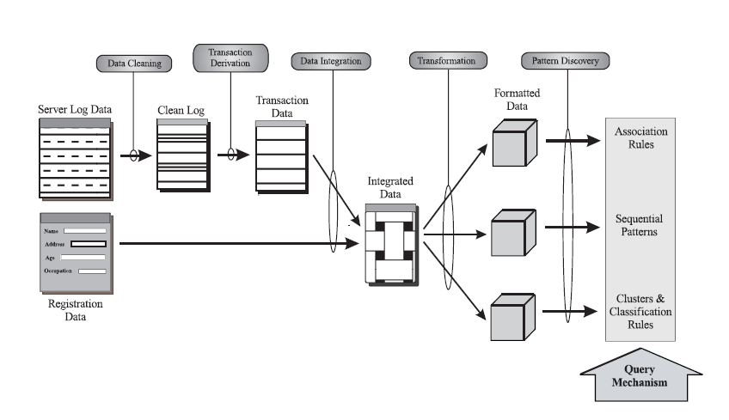
Web Usage Mining Model

Slide 37
Web Usage Data Preprocessing
DATA CLEANING
- Clean/Filter raw data to eliminate redundancy
LOGICAL CLUSTERS
- Notion of Single User Transaction

Slide 38
Data Cleaning
There are a variety of files accessed as a result of a request by a client to view a particular Web page.
These include image, sound and video files, executable cgi files , coordinates of clickable regions in image map files and HTML files.
Thus the server logs contain many entries that are redundant or irrelevant for the data mining tasks
User Request : Page1.html
Browser Request : Page1.html, a.gif, b.gif
3 Entries for same user request in the Server Log, hence redundancy.
Page1.html
a.gif
b.gif

Slide 39
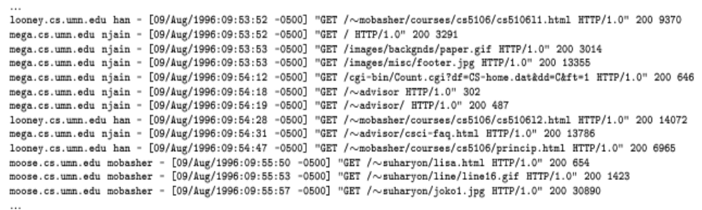
Data Cleaning cont…
Hostname
Date : Time
Request
SOLUTION
All the log entries with filename suffixes such as, gif, jpeg, GIF, JPEG, JPG and map are removed from the log.

Slide 40
Logical Clusters
Representation of a Single User Transaction.
One of the significant factors which distinguish Web mining from other data mining activities is the method used for identifying user transactions
The clustering is based on comparing pairs of log entries and determining the similarity between them by means of some kind of distance measure.
Entries that are sufficiently close are grouped together
PROBLEMS:
To determine an appropriate set of attributes to cluster.
To determine an appropriate distance metrics for them.

Slide 41
Logical Clusters
Time Dimension for clustering the log entries
Let L be a set of server access log entries
A log entry l Є L includes -
the client IP address l.ip,
the client user id l.uid,
the URL of the accessed page l.url and
the time of access l.time
Δt = Time Gap
l1.time – l2.time < = t
Δ

Slide 42
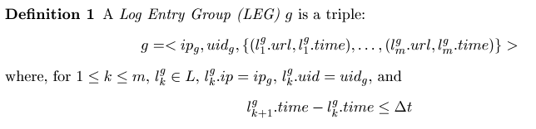
Logical Cluster Post Processing
PARTITIONING
- Logical Clusters are partitioned based on IP Address and User Ids

Slide 43
Web Usage Mining Model

Slide 44
Association Rules
X == > Y (support, confidence)
60% of clients who accessed /products/, also accessed /products/software/webminer.htm.
30% of clients who accessed /special-offer.html, placed an online order in /products/software/.

Slide 45
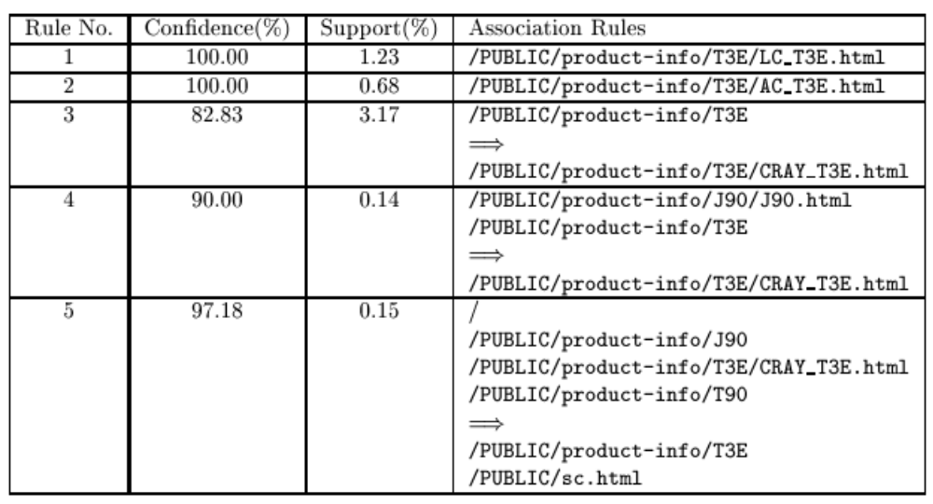
Association Rules cont…

Slide 46
Mining Sequential Patterns
Support for a pattern now depends on the ordering of the items, which was not true for association rules.
For example: a transaction consisting of URLs ABCD in that order contains BC as an subsequence, but does not contain CB
60% of clients who placed an online order for WEBMINER, placed another online order for software within 15 days

Slide 47
Clustering & Classification
clients who often access /products/software/webminer.html tend to be from educational institutions.
clients who placed an online order for software tend to be students in the 20-25 age group and live in the United States.
75% of clients who download software from /products/software/demos/ visit between 7:00 and 11:00 pm on weekends.

Slide 48
Abstract
Analysis of web site usage data involves two significant challenges
Volume of data
Structural complexity of web sites
Visual Web Mining
Apply Data Mining and Information Visualization techniques to web domain
Aim : To correlate the outcomes of mining Web Usage Logs and the extracted
Web Structure, by visually superimposing the results.

Slide 49
Terminology
Information Visualization
use of computer-supported, interactive,visual representations of abstract data
to amply cognition
User Session
compact sequence of web accesses by a user
Visual Web Mining
- application of Information Visualization techniques on results of Web Mining
- to further amplify the perception of extracted patterns, rules and regularities

Slide 50
Visual Web Mining Framework
provides a prototype implementation for applying information visualization techniques to the results of Data Mining.
Visualization to obtain :
- understanding of the structure of a particular website
web surfers’ behavior when visiting that site
Due to the large dataset and the structural complexity of the sites, 3D visual representations used.
Implemented using an open source toolkit called the Visualization ToolKit (VTK).

Slide 51
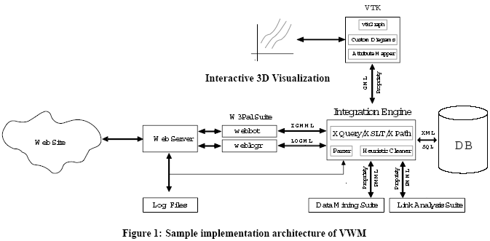
Visual Web Mining Architecture

Slide 52
Visual Web Mining Architecture
Input : web pages and web server log files
A web robot (webbot) is used to retrieve the pages of the website.
In parallel, Web Server Log files are downloaded and processed through a sessionizer and a LOGML file is generated.
The Integration Engine is a suite of programs for data preparation,
i.e., cleaning, transforming and integrating data.

Slide 53
Visual Web Mining Architecture
The Visualization Stage : maps the extracted data and attributes into visual images, realized through VTK extended with support for graphs.
VTK : set of C++ class libraries accessible through
- linkage with a C++ program, or
- via wrappings supported for scripting languages (Tcl, Python or Java),
here tcl script used.
Result : interactive 3D/2D visualizations which could be used by analysts to compare actual web surfing patterns to expected patterns

Slide 54
Results
VWM provides an insight into specific, focused, questions that form a
bridge between high-level domain concerns and the raw data :
What is the typical behavior of a user entering our website?
What is the typical behavior of a user entering our website in page A from ‘Discounted Book Sales’ link on a referrer web page B of another web site?
What is the typical behavior of a logged in registered user from Europe entering page C from link named “Add Gift Certificate” on page A?

Slide 55
Visual Representation
analogy between the ‘flow’ of user click streams through a website, and the flow of fluids in a physical environment in arriving at new representations.
representation of web access involves locating ‘abstract’ concepts (e.g. web pages) within a geometric space.
Structures used:
- Graphs
Extract tree from the site structure, and use this as the
framework for presenting access-related results through glyphs and
color mapping.
- Stream Tubes
Variable-width tubes showing access paths with different traffic are
introduced on top of the web graph structure.

Slide 56
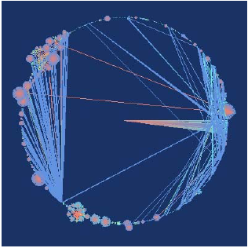
Design and Implementation of Diagrams
This is a visualization of the
web graph of the Computer
Science department of
Rensselaer Polytechnic Institute(http://www.cs.rpi.edu).
Strahler numbers are used for
assigning colors to edges.
One can see user access paths scattering from first page of website
(the node in center) to cluster of web pages corresponding to
faculty pages, course home pages, etc.

Slide 57
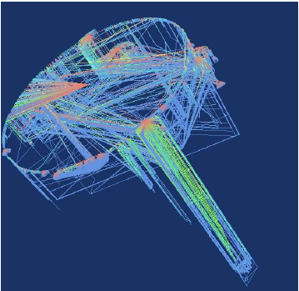
Adding third dimension enables visualization of more information and clarifies user behavior in and between clusters. Center node of circular basement is first page of web site from which users scatter to different clusters of web pages. Color spectrum from Red
(entry point into clusters) to Blue (exit points) clarifies behavior of users.
This is a 3D visualization of web usage for above site.The cylinder like part of this figure is visualization of web usage of surfers as they browse a long HTML document.

Slide 58
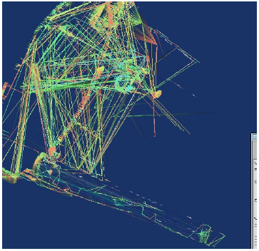
User’s browsing access pattern is amplified by a different
coloring. Depending on link structure of underlying
pages, we can see vertical access patterns of a user drilling down the cluster, making a cylinder shape (bottom-left corner of the figure). Also users following links going down a hierarchy of webpages makes a cone shape and users going up hierarchies,e.g., back to main page of website makes a funnel shape
(top-right corner of the figure).

Slide 59
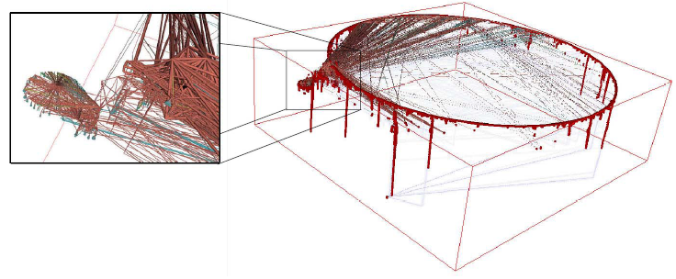
Right: One can observe long user sessions as strings falling off clusters. Those are special type of long sessions when user navigates sequence of web pages which come one after the other under a cluster, e.g., sections of a long document. In many cases we found web pages with many nodes connected with Next/Up/Previous hyperlinks.
Left: A zoom view of the same visualization

Slide 60
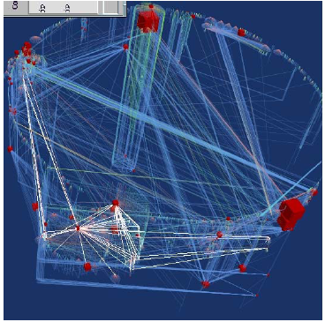
Frequent access patterns extracted by web mining
process are visualized as a
white graph on top of embedded and colorful graph of web usage.

Slide 61
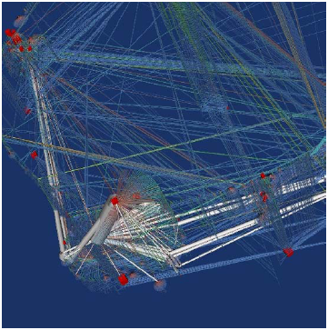
Similar to last figure with addition of another attribute,
i.e., frequency of pattern which is rendered as thickness of
white tubes; this would significantly help analysis of results.

